Slide 1
EPILEPSY IN BRAIN TUMOR
Fariborz Khorvash
Professor of Neurology
Fellowship of Headache and facial pain

Slide 2
DEFINITION
Epileptic seizures occur frequently in brain tumor patients and often represent the first clinical sign of a brain tumor and diagnosis of epilepsy is usually made after one seizure that meaning
BRAIN TUMOR RELATED EPILEPSY(BTRE)

Slide 3
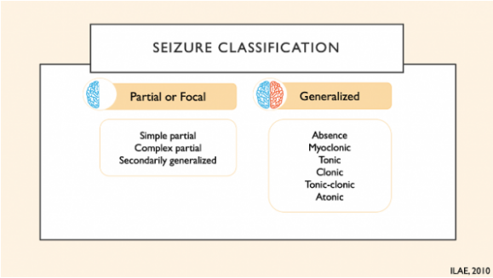

Slide 4
Epileptic seizures, especially when uncontrolled, have a negative effect on
social and economic participation, morbidity, health-related quality of life, and neurocognitive functioning in brain tumor patients Therefore, achieving enduring seizure control is one of the main treatment goals in brain tumor patients

Slide 5
incidence
Primary brain tumors account for about 1.6% of all cancers
Brain metastasis occur in about 25% of solid tumors
About 25–60% of patients with intracranial tumor may develop symptoms of epilepsy
In BTRE, seizures may occur either as an initial symptom that leads to the diagnosis of tumor (seen in about 30–50% of patients) or during the course of the disease (seen in 10–30% of patients)

Slide 6
Risk for epilepsy in brain tumor
1-histology
The incidence of seizures is generally higher in patients with low-grade compared to high-grade brain tumors
Up to 80%in low grade glioma
62-68% glioblastoma
40-47% meningioma
20%-25% brain metastasis

Slide 7
Risk for epilepsy in brain tumor
2-location of tumor
Frontal, parietal and temporal localization of the brain tumor is reportedly associated with a higher risk of seizures compared to occipital localization

Slide 8
Risk for epilepsy in brain tumor
In patients with brain metastases, > 4 metastases, high risk location of metastases (defined as frontal, parietal, temporal, or occipital cortex) and melanoma as the primary tumor are risk factors for the occurrence of BTRE

Slide 9
BRAIN METASTASIS
The incidence of seizures in brain metastasis is lower , ranging from 24 to 34%
Tumor type and location are the most important factors associated with the risk of seizures in brain metastases
highest rate for seizures:
1-melanoma 2-lung cancer
less frequent: ovarian/colorectal/prostate

Slide 10
BRAIN METASTASIS
The risk is higher for patients with metastases involving or adjacent to brain regions with high epileptogenicity, such as motor cortex and temporal lobe
Other risk factors are multiplicity of lesions, and headache or cognitive deficit at onset

Slide 11
pathophysiology (mechanism of epileptogenecity)
Mechanical compression
imbalance of vascularization and oxygen demand of the tumor,
inflammatory processes
neurotransmitter dysbalance

Slide 12
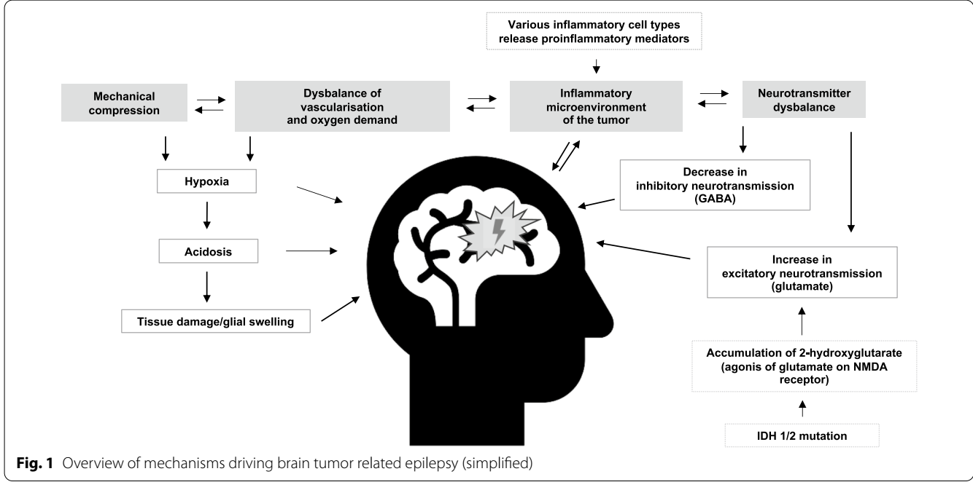
mechanisms of pathogenesis

Slide 13
TREATMENT OF BTRE
Antiepileptic drug
Surgery
Chemotherapy
radiotherapy

Slide 14
ANTIEPILEPTIC DRUG
criteria for the choice of ASM in patients with BTRE are:
(1) mechanism of action & efficacy
(2) dosage form (oral, intravenous)
(3) avoidance of impairing side effects

Slide 15
About 60% of patients with brain tumors do not become seizure free with the first ASM and of those patients, only 40% eventually become seizure-free with a second line monotherapy or polytherapy

Slide 16
choice of AED
Levetiracetam(FIRST LINE)
LACOSAMIDE
LAMOTRIGIN

Slide 17
LEVEBEL
BENEFITS:
can be applied intravenously
fast titration is possible
virtually no pharmacokinetic interaction
SIDE EFFECT:
neuropsychiatric side effects, particularly in patients with frontal tumors

Slide 18
LACOSAMIDE
Intravenous application is available
Titration is fast
The rate of neuropsychiatric side effects is low
There are very few interactions with other drugs
Before initiation of LCM an atrioventricular block of second or higher degree has to be excluded via electrocardiogram

Slide 19
Management of recurrent seizures
control of tumor growth(Particularly in high grade gliomas recurrent seizures can be a sign of progression )
control of seizure frequency: Prampanel
Brivaracetam
cenobamate

Slide 20
status epilepsy in brain tumor
In adults, 7% of status epilepticus (SE) are due to brain tumors and SE in BTRE is associated with significant mortality
At present, treatment recommendations for SE in BTRE are based on treatment recommendations for SE in all epilepsies

Slide 21
surgery
Gross total resection is associated with a substantially better seizure outcome in glioma patients compared to nongross total resection which also applies to brain metastases and meningioma
In glioblastoma, supra total surgical resection extends beyond the contrast-enhancing portion of the tumor and has been associated with improved overall survival and seizure control compared to gross total resection

Slide 22
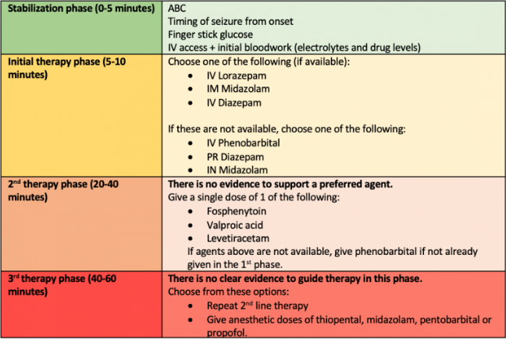

Slide 23
chemotrapy
Most commonly administered chemotherapy agents in glioma patients:
- temozolomide, PCV (i.e. procarbazine, CCNU [lomustine], and vincristine
- lomustine monotherapy

Slide 24
chemotherapy has been associated with an improved seizure outcome with seizure freedom rates ranging from 13% to 60% (administered PCV) and 13% to 50% (administered temozolomide) in low-grade glioma patients
in elderly glioblastoma patients the beneficial effect of temozolomide on seizure outcome seems minimal

Slide 25
Radiotherapy
A beneficial effect of radiotherapy on seizure outcome in brain metastases has not yet been established while it has been demonstrated in low-grade glioma patients with seizure freedom rates ranging from 20% after focal radiotherapy to 80% at 6 months after brachytherapy

