Slide 2
Laser interstitial thermal therapy (LITT)
Dr. Majid Mellat

Slide 3
Laser interstitial thermal therapy (LITT) first described for brain tumors by Sugiyama et al.1 in 1990
minimally invasive technique
achieves stereotactic tissue ablation via delivery of thermal energy to a designated brain region
Given its minimally invasive nature and ability to access lesions in problematic locations, LITT has been adopted for a variety of neurosurgical operations, including those for intracranial tumors, radiation necrosis, and epilepsy
thermal energy is strategically delivered to induce hyperthermic damage of the target tissue while magnetic resonance thermometry facilitates real-time monitoring of the thermal energy being delivered

Slide 4
It is well established that patients with tumors near eloquent areas or in deep-seated regions that preclude safe aggressive resection face a worse prognosis.
In this setting, LITT may offer an alternative therapeutic approach that allows cytoreduction for difficult-to-access tumors that otherwise is infeasible with traditional surgery
There are no established guidelines regarding indications for LITT with respect to tumor size, disease, or patient characteristics such as age and functional status

Slide 5
Operative principles
performed stereotactically and generally in an interventional or intraoperative MRI suite while patients are under general anesthesia
When required, a needle biopsy may be performed before treatment for definitive tissue diagnosis
Using preoperative imaging, the lesion is targeted, a simple burr hole is created
a laser probe is inserted through a burr hole along a predetermined trajectory
An optical fiber is then delivered to the desired depth, and laser light is interstitially delivered with low power over a long period of time to heat the tissues

Slide 6
Temperature within the lesion is measured throughout the procedure using MRI thermometry
LITT can be coupled with magnetic resonance (MR) thermography allowing for accurate real-time temperature feedback in the ablation radius throughout the procedure
There are two different systems on the market, both of which provide visual representations of temperature over a certain time to induce cell death, usually 43°C (42.5-45) for 10 min>>>>> this temp affect the tumor tissue, but healthy tissue is less affected
anticoagulation should be reversed in patients before proceeding with LITT, given the known risk of hemorrhage

Slide 17
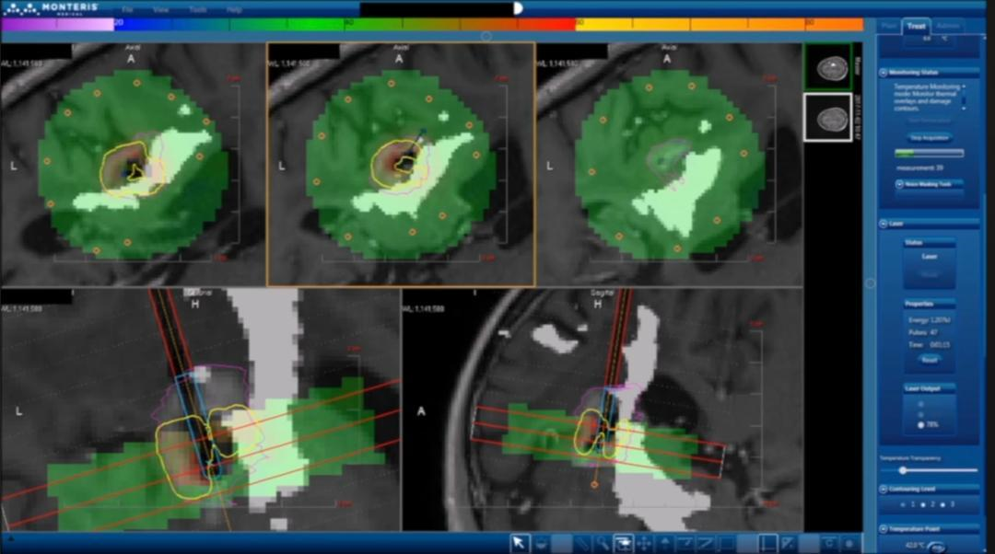

Slide 21
Post-operative status
Using MRI
First few days: increased in size of lesion few to edema in surrounding area, usually a necrotic center and edema in more distant area
Few weeks: due to reduction of edema and formation of granulation tissue, the size of lesion decrease and no edema is seen
Given the amount of cerebral edema after LITT in the acute period, corticosteroid use is common.
Postoperative steroid use varies by surgeon and can range from 1 week to chronic maintenance therapy

Slide 22
Lesions that are more favorable to LITT are deep seated, spherical/oblong, and well circumscribed and have a trajectory that misses important structures like the ventricles or large arteries
Lesions that are not favorable are hypervascular, diffuse, and very large lesions
Ideally the complete lesion would be covered by the thermal damage threshold (TDT) lines, although the presence of eloquent areas or heat sinks such as ventricles and blood vessels can limit lesion coverage

Slide 23
LITT for gliomas
The standard of care for gliomas, especially high- grade gliomas such as GBMs, is surgical resection with adjuvant chemotherapy and radiation
Maximal resection had more benefit compared with partial resection or biopsy.
LITT has been described in a variety of primary brain tumors, predominantly gliomas and specially glioblastoma multiforme (GBM)
in both newly diagnosed and recurrent tumors

Slide 24
Especially offered for gliomas which are deemed surgically inoperable due to deep- seated locations or being near eloquent regions of the brain or for patients who are deemed poor candidates for open surgery due to comorbidities or old age.
Some of the tumor locations ideal for upfront LITT therapy include the deep gray matter structures such as thalamus and basal ganglia, corpus callosum, or insula
Muir and colleagues presented their series of 20 patients with newly diagnosed, “inoperable” GBMs and concluded that those patients had similar survival times and local recurrence rates as patients who underwent surgical resection.

Slide 25
key characteristics of LITT to grow popular among the neurosurgery world :
efficacy in achieving similar cytoreduction of tumors as does standard surgical resection
allowing for real-time monitoring of tumor ablation, hence minimizing damage to nearby eloquent areas and lowering risk of developingnew neurologic deficits
Lower complication rate for LITT compared with open craniotomy

Slide 26
Treatment outcomes primary brain tumors
Difference between recurrent or primary brain tumor
Currently it seems that patients treated with LITT frontline for GBM have reduced PFS and OS compared with recurrent GBM
but this could be confounded by other important variables such as tumor mutations, size, location, and the functional status of the patient preoperatively.
Tumor volume less than 11 cm3 and age less than 70 were associated with significantly improved OS
The extent of ablation (EOA) would appear to be another significant predictor of outcomes after LITT >>>> more complete ablation of the tumor (less than 0.05 cm3 of contrast-enhancing tumor not ablated) was associated with increased OS
EOA was the strongest predictor of local control

Slide 27
Results of LITT for lesions within the posterior fossa.
Ashraf and colleagues presented: Lesions tended to be smaller in size compared with their supratentorial counterparts.
The complication rate was approximately 24% and it was advised that extra caution must be taken to prevent damage to surrounding neural structures as there is relatively more surrounding eloquent tissue in the posterior fossa compared with the supratentorial space.
Dadey and colleagues further demonstrated the importance of precise and accurate placement of the laser probe using stereotactic guidance to ensure effective ablation of these deep-seated lesions without major complications.
Other studies also supported LITT as an effective option for posterior fossa tumors

Slide 28
A feature of LITT that sets it apart from other techniques is real- time thermal monitoring
McNichols and colleagues described a computer-controlled laser thermal therapy system, which they used to produce lesions in canine and porcine brains and used MRI-based feedback to control the thermal energy and laser ablation.
This system was effective in regulating heat, eliminating carbonization and vaporization, and protecting the fiber optic applicators of the lasers.
Ultimately, the MRI estimation of thermal dose correlated with thermal necrosis
The compatibility of LITT with real-time MRI thermometry

Slide 29
Other benefits of LITT
Use multiple times without concerns for developing dose toxicity, as with radiation resistance, as with chemotherapy
Muir and colleagues published their cohort of patients who underwent LITT multiple times for recurrent GBMs and found that the patients tolerated the procedure well and also had a meaningful survival
shorter hospital stays compared with open craniotomies with faster recoveries
increased permeability of therapeutic drugs due to disruption of the blood brain barrier (BBB).

Slide 30
LITT for recurrent gliomas
Repeat surgery in a potentially already frail patient can lead to morbidity and wound healing issues due to prior chemotherapy and radiation.
At the time of recurrence, many patients are not as healthy to tolerate further open surgery
Factors found to be associated with poor postoperative survival in patients with recurrent GBMs included tumor location in eloquent brain regions, Karnofsky performance status, and tumor volume

Slide 31
LITT offers a safer alternative that can still decrease tumor burden offering comparable cytoreductive effects through ablation.
Although no studies have directly compared the efficacy of LITT versus any chemotherapeutic regimens, individual studies have shown comparable, if not superior, results of LITT to those of chemotherapy
A pooled analysis of all available literature suggest that LITT may be favorable to chemotherapy for the treatment of recurrent, progressive glioblastomas.

Slide 32
LITT in the treatment of brain metastases
LITT is mainly indicated to treat metastatic brain lesions refractory to standard treatment (failing radiation or craniotomy)
which are deeply seated or surgically inaccessible,
especially in patients too frail to tolerate major surgical stress
Fordeep-seated lesions in eloquent regions, diffusion tensor imaging (DTI) tractography can be incorporated to guide the extent of ablation and help preserve important tract.

Slide 33
Treatment outcomes metastatic brain tumors
One study: When comparing LITT with open craniotomy for tumor resection for BMs, there was no significant difference in the PFS and OS
Other study: found that more patients had resolution of their preoperative symptoms with craniotomy compared with LITT

Slide 34
The degree of ablation seems to be more strongly associated with outcome in the BM data
Local disease progression was seen in 25% of completely ablated BMs compared with 62.5% of incompletely ablated BMs
In a systematic review of 13 publications using LITT after radiation therapy for BMs, local control and PFS occurred more often in completely ablated lesions.
a retrospective study of LITT procedures on 24 patients with BM, PFS was significantly longer when greater than 97% of the tumor was ablated
tumor size was found to be a significant predictor of PFS
smaller tumor volumes responding better than larger volumes tumors
Multiple tumor? Require much longer time

Slide 35
Extent of ablation (EOA)
The extent of ablation (EOA) would appear to be another significant predictor of outcomes after LITT
more complete ablation of the tumor (less than 0.05 cm3 of contrast-enhancing tumor not ablated) was associated with increased OS
EOA was the strongest predictor of local control
Dynamic contrast-enhanced MR imaging (DCE-MRI), adynamic T1-weighted perfusion imaging technique, can be used to characterize the vasculature of tissue from which many quantifiable physiologic and non-physiologic variables can be extracted.
The initial area under the time-to-signal intensity curve at 60 s (iAUC60) is one such quantitative parameter that has been evaluated to assess the presence of viable tissue after LITT >>>>> Higher iAUC60 values were associated with shorter time to local recurrence

Slide 37
Images of 67-year-old male patient with a brain metastases recurrence after SRS from non-small lobe, compatible with recurrent tumor;
(A) Pre-ablation axial T1CþMRI show-ing a deep seated ring enhancement in the left parietal ahigh signal intensity inside the lesion suggesting high vascularization; B) Pre-ablation Dynamic Contrast-Enhanced k-trans MR showing cell lung cancer. (C) Post-ablation axial T1CþMRI showing the classic eggshell enhancement in the bordersof the ablation; (D) Post-ablation MRI subtraction compatible with complete ablation; (E) Post-ablation axial Dynamic Contrast-Enhanced k-transMR showing lowsignal intensity compatible with no viable tissue within the ablation zone; (F) One month post-ablation axial T1CþMRI showing eggshell enhancement and nosigns of local recurrence; (G) Three month post-ablation axial T1CþMRI without local recurrence; (H) Six month post-ablation axial T1CþMRI with only remnantsigns of ablation

Slide 39
Images of 66-year-old female patient with metastatic breast cancer to the brain with a tumor recurrence after treatment with SRS.
(A) Pre-ablation axialT1CþMRI showing a heterogeneous ring-enhancing lesion in the left frontoparietal region, compatible with recurrent tumor, note the large caliber vessel in theanterior third of the lesion (red arrow); (B) Pre-ablation sagittal T1CþMRI showing the large caliber vessel crossing the lesion; (C) ) Pre-ablation Dynamic Contrast-Enhanced k-trans MR showing a high signal intensity in the lesion’s margins compatible high vascularization; (D) Post-ablation axial T1CþMRI showing the classiceggshell enhancement in the margins of the ablation, notice in the anterior margin a solid enhancement compatible with unablated tissue (yellow arrow), it is pos-sible that the large vessel worked as a heat sink preventing the complete ablation of the lesion; (E) Post-ablation MRI subtraction showing increasedenhancementin the anterior margin of the ablation zone (yellow arrow); (F) Post-ablation axial Dynamic Contrast-Enhanced k-trans MR showing increased signal in the anteriormargin of the ablation zone (yellow arrow); (G) One month post-ablation axial T1CþMRI showing eggshell enhancement a remnant unablated tumor in the anter-ior margin of the ablation zone; Three months post-ablation axial T1CþMRI showing tumor recurrence in the anterior part of the ablation zone.

Slide 40
LITT for radiation necrosis (RN)
RN is a known complication after stereotactic radiosurgery
occurs in about 6.7–25.8% of patients
RN lesions can progress irreversibly or may stabilize without need for treatment, but predicting which patients will fall into either category is extremely difficult

Slide 41
In patients who could not tolerate open surgical resection, LITT has also been used successfully for symptomatic RN
Patients with RN respond very well to LITT in regard to symptom control and PFS.
PFS was significantly longer for patients who previously had grade 2 tumors compared with BMs, grade 3 or grade 4 primary CNS tumors
LITT may be a good option for patients with RN who require long-term steroids or have progressive neurologic symptoms

Slide 42
Complications
83% of patients
most common:
temporary or permanent neurologic deficits (8.82–35.5% and 2.17–7.14%, respectively)
cerebral edema, Seizures and intracranial hemorrhage (0.98–14.2%)
less common:
hyponatremia, hydrocephalus, headache,malignant cerebral edema, and meningitis
Catheter misplacement has been quoted as high as 14.2%, but this problem has likely been reduced as stereotaxis and surgical planning have improved
In a series of 120 patients, mortality occurred in 3 cases
Post-LITT motor weakness: coverage of the corticospinal tract during surgical planning of lesion ablation is associated with increased risk of temporary or permanent motor weakness.

